Slide 1
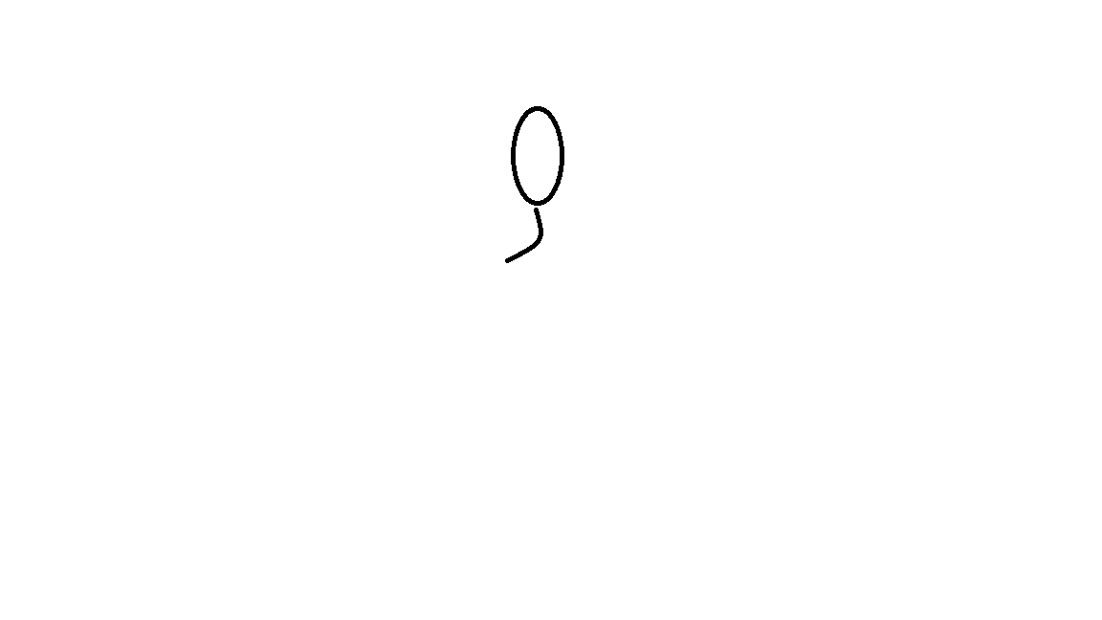
INPUT DEVICES

Slide 2
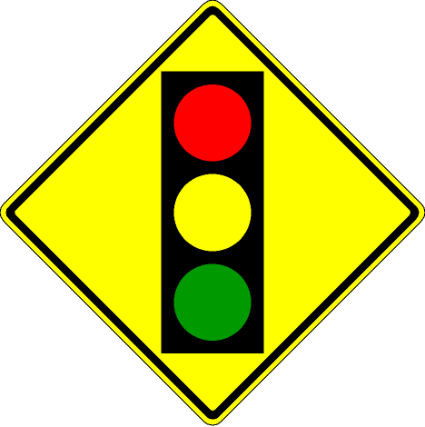
Traffic light is a visual signal to control the flow of traffic at intersections
  1.Red light is a signal to stop.
  2.Green light is a signal to go.
  3.Yellow light is signal to go with caution

